Slide 1
Topic 3.5 –Mole Concepts: Part 1
Unit 1

Slide 2
Vocab List
molar mass
mass
mole
Avogadro’s Number
concentration
volume

Slide 3
Learning goal
Topic 3.3: Mole concept and law of conservation of mass
Determine limiting reactants.
Discriminate between experimental and theoretical yield.
Analyse data to determine percentage and theoretical yield. (Formula: percentage yield (%) = (experimental yield / theoretical yield) ×100)

Slide 4
Stoichiometry
1. Balance the equation
2. Determine the number of moles of products/reactants given
3. Determine the molar ratio of relevant products/reactants
4. Use this to determine the number of moles or grams of the required substance.

Slide 5
Stoichiometry - Examples
A solution containing 20.0g of dissolved Sodium Hydroxide (NaOH) is added to a solution containing excess Aluminium Nitrate (Al(NO₃)₃), to form a solution of Sodium Nitrate (NaNO₃) and Aluminium Hydroxide (Al(OH)₃) precipitate.
Write a balanced equation for this reaction.
Determine the mass of the precipitate formed.

Slide 6
Stoichiometry - examples
Sulphuric acid is formed when sulphur dioxide (SO₂) and water react with oxygen gas in the presence of a catalyst. If 3.20g of SO₂ react, calculate the mass of:
O₂ that reacts
Sulphuric acid (H₂SO₄) that is produced

Slide 7
Limiting reagent
Limiting reagent – reactant that gets completely used up.
Determines when the reaction stops.
‘Limits’ the extent of the reaction.
Excess reagents – reactants that are not used up when the reaction has finished.
There is an abundance of this reagent – more than what is needed.
Also called, “in excess”
Additional Resource: https://phet.colorado.edu/en/simulations/reactants-products-and-leftovers
Leftovers are ‘in excess’. Components that are used up are ‘limiting’.

Slide 8
Limiting reagent – example
A solution containing 20.0g of dissolved Sodium Hydroxide (NaOH) is added to a solution containing 25.0g Aluminium Nitrate (Al(NO₃)₃), to form a solution of Sodium Nitrate (NaNO₃) and Aluminium Hydroxide (Al(OH)₃) precipitate.
Write a balanced equation for this reaction.
Determine the limiting reagent.
Determine the mass of the precipitate formed.

Slide 9
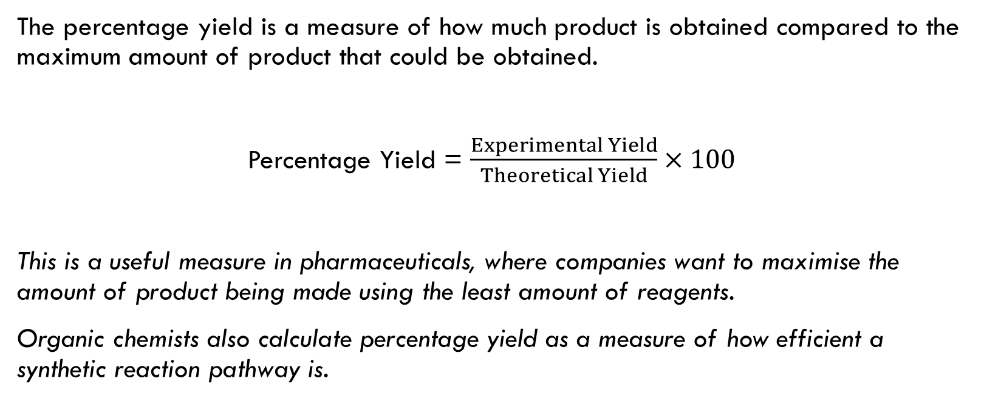
Percentage yield
The percentage yield is a measure of how much product is obtained compared to the maximum amount of product that could be obtained.
Percentage Yield = $\frac{Experimental Yield}{Theoretical Yield}×100$
This is a useful measure in pharmaceuticals, where companies want to maximise the amount of product being made using the least amount of reagents.
Organic chemists also calculate percentage yield as a measure of how efficient a synthetic reaction pathway is.

Slide 10
Percentage yield – example
Sulphuric acid is formed when sulphur dioxide (SO₂) and water react with oxygen gas in the presence of a catalyst. If 3.20g of SO₂ react, calculate the mass of:
O₂ that reacts
Sulphuric acid (H₂SO₄) that is produced
If 4.0g of H₂SO₄ is obtained in an experiment from 3.2g SO₂, determine the experimental percentage yield of sulphuric acid produced.

